Slide 1
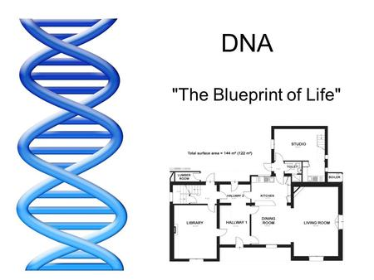

Slide 2
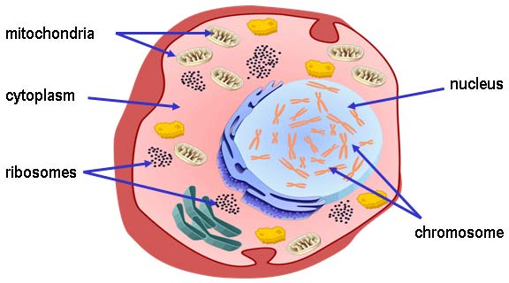

Slide 3
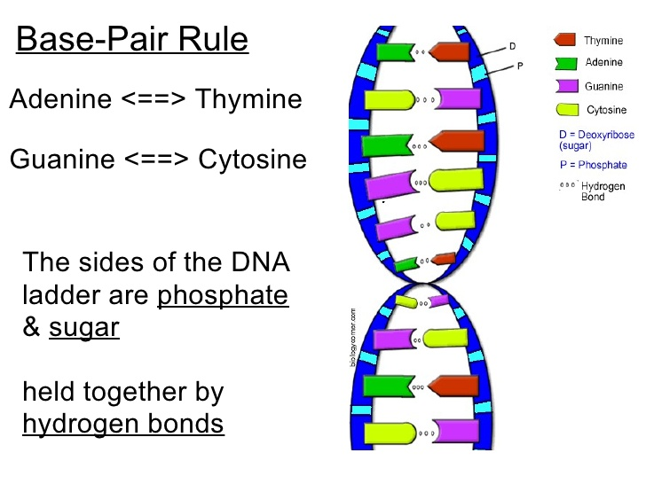

Slide 4
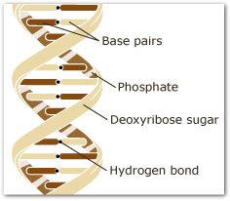

Slide 5
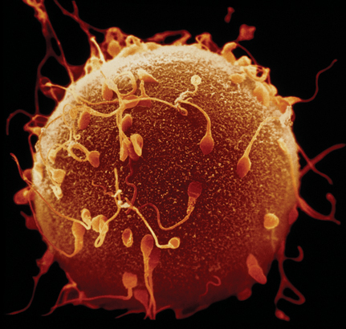
KEY CONCEPT
Genes encode proteins that produce a diverse range of traits.

Slide 6
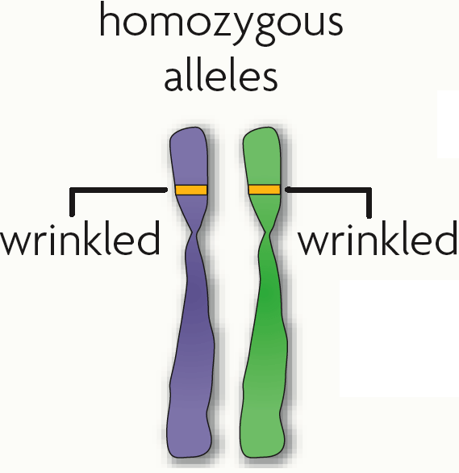

The same gene can have many versions called alleles.
A gene is a piece of DNA that directs a cell to make a certain protein.

Slide 7
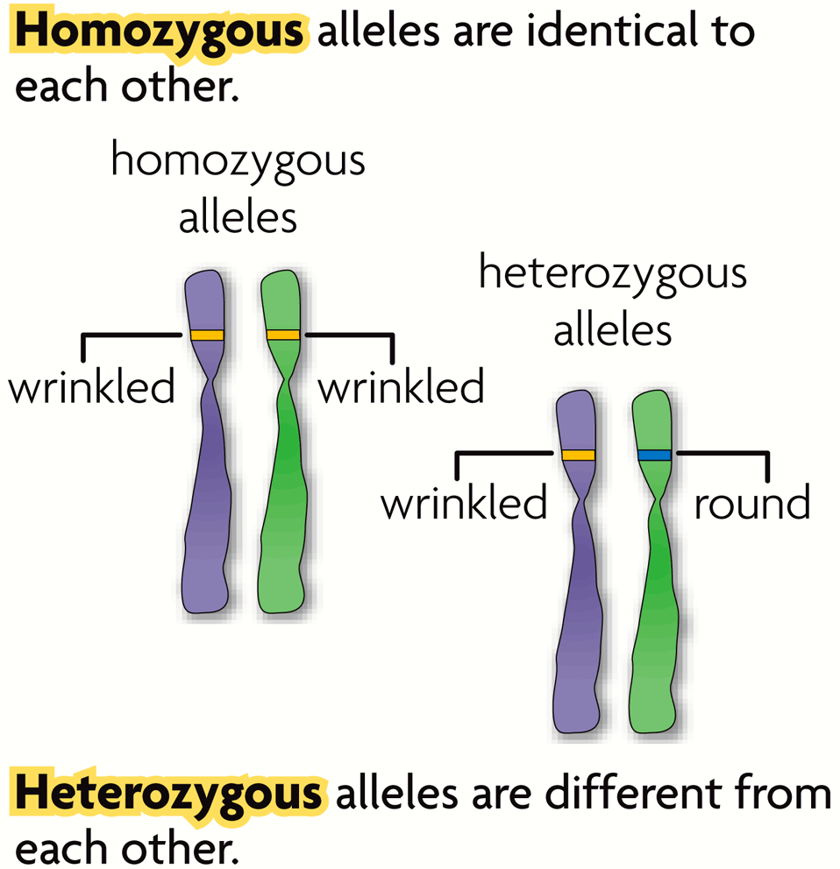
An allele is any alternative form of a gene occurring at a specific locus on a chromosome. Alleles are often represented by letters.
  Each parent donates one allele for every gene.
  Homozygous describes two alleles that are the same at a specific locus.
  Heterozygous describes two alleles that are different at a specific locus.
RR
Rr

Slide 8
An allele is any alternative form of a gene occurring at a specific locus on a chromosome. Alleles are often represented by letters.
GENE = eye colour
    hair colour
    ALLELE = blue or brown
    blonde or brown
RR
Rr

Slide 9
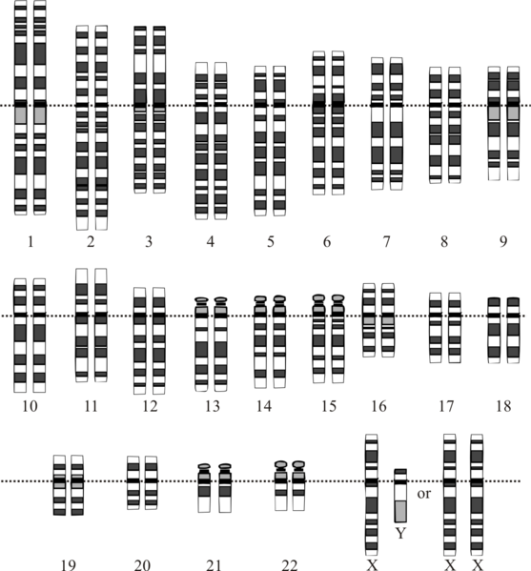
Genes influence the development of traits.
All of an organism’s genetic material is called the genome.
A genotype refers to the makeup of a specific set of genes. Examples: Bb, bb, BB
A phenotype is the physical expression or appearance of a trait. Examples: tall, round, blue

Slide 10
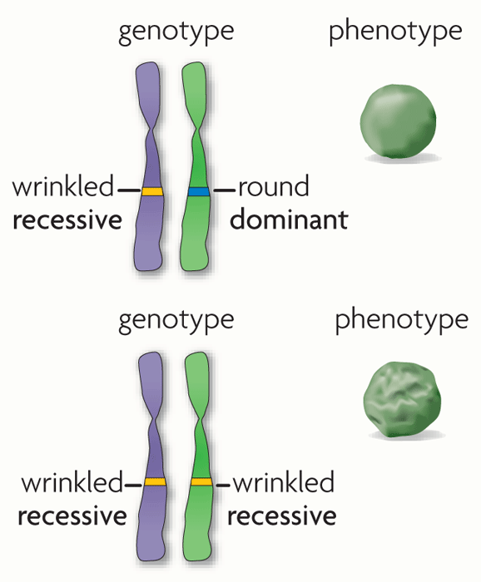
Alleles are often represented using letters.
  A dominant allele = expressed as a phenotype
  A recessive allele = masked by dominant. Only expressed as a phenotype only when two copies are present.

